Slide 1
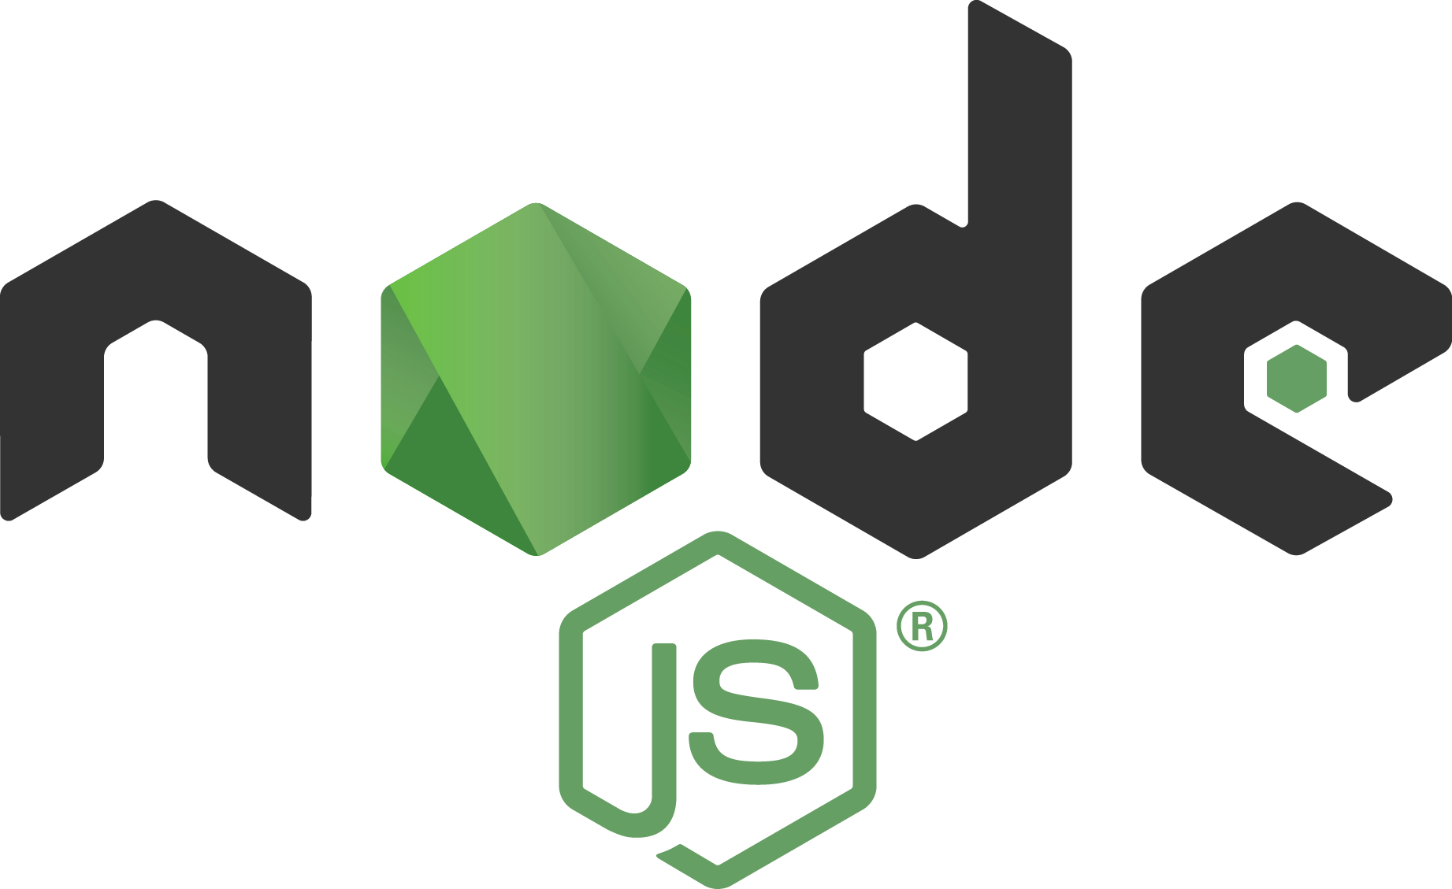
Node.js internals

Slide 2
What is Node.js?
As an asynchronous event-driven JavaScript runtime, Node.js is designed to build scalable network applications.
Node.js® is a JavaScript runtime built on Chrome's V8 JavaScript engine.

Slide 3
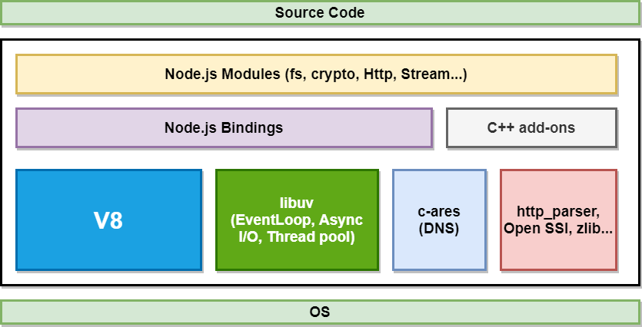
Node.js architecture. The big picture.

Slide 4
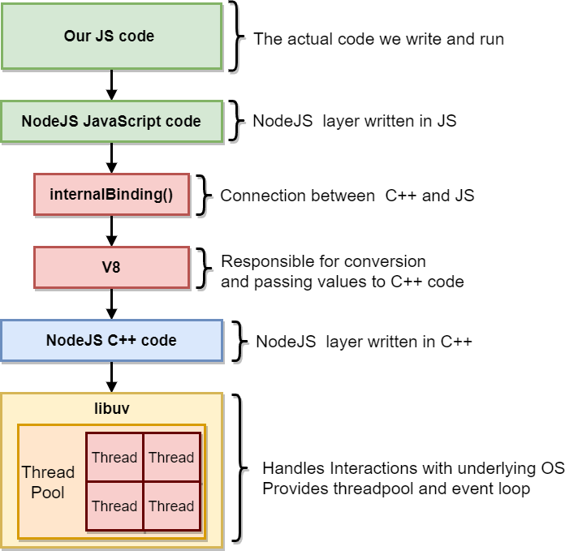
Node.js modules architecture overview
A lot of Node.js functions rely on C++ code
internalBinding() bridges JS and C++ world
PBKDF2 C++ export and implementation
V8 converts JS values to C++
Some of operations are executed on the threadpool with help of libuv

Slide 5
Threads?
But node is single threaded!*
*Except when it is not

Slide 6
All the JS, V8 and event loop run in one thread called the main thread

Slide 7
Some of Node.js async C++ backed methods might run outside of the main thread!

Slide 8

It is code time

Slide 9
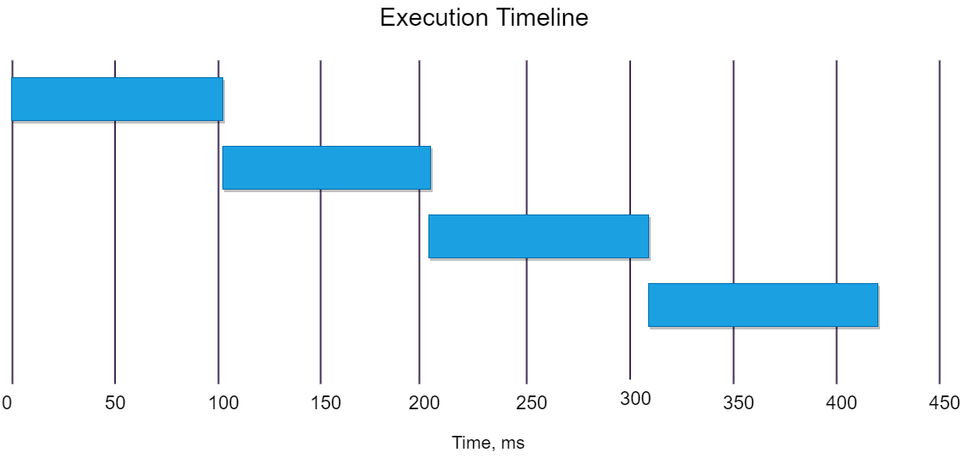
Synchronous crypto results 4 calls x 4 cores

Slide 10
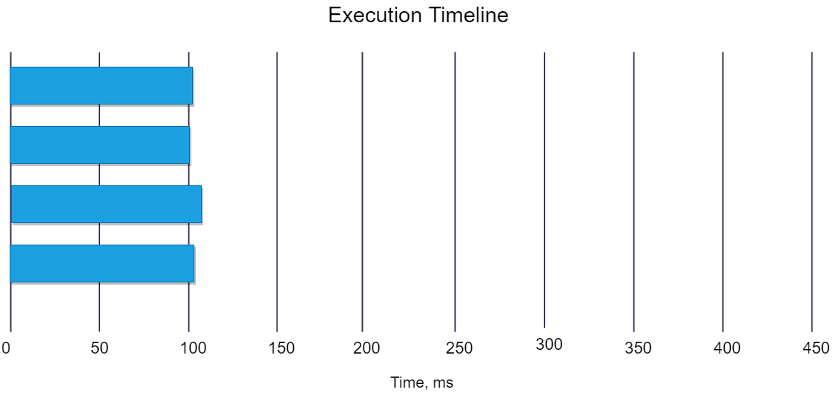
Async crypto results 4 calls x 8 cores

Slide 11
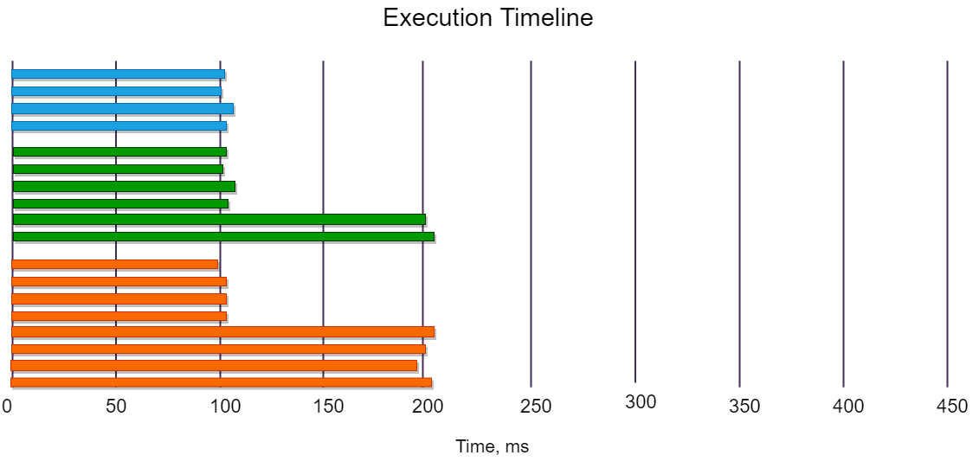
Async crypto results 4-6-8 calls x 8 cores

Slide 12

libuv
Another important dependency is libuv, a C library that is used to abstract non-blocking I/O operations to a consistent interface across all supported platforms. It provides mechanisms to handle file system, DNS, network, child processes, pipes, signal handling, polling and streaming. It also includes a thread pool for offloading work for some things that can't be done asynchronously at the operating system level.

Slide 13
Thread pool
Node uses the Worker Pool to handle "expensive" tasks. This includes I/O for which an operating system does not provide a non-blocking version, as well as particularly CPU-intensive tasks.

Slide 14
Node API using TP
I/O-intensive
DNS: dns.lookup(), dns.lookupService().
File System: All file system APIs except fs.FSWatcher() and those that are explicitly synchronous use libuv's threadpool.
CPU-intensive
Crypto: crypto.pbkdf2(), crypto.scrypt(), crypto.randomBytes(), crypto.randomFill(), crypto.generateKeyPair().
Zlib: All zlib APIs except those that are explicitly synchronous use libuv's threadpool.

Slide 15
Other modules and thread pool
In many Node applications, these APIs are the only sources of tasks for the Worker Pool. Applications and modules that use a C++ add-on can submit other tasks to the Worker Pool.
Example

Slide 16
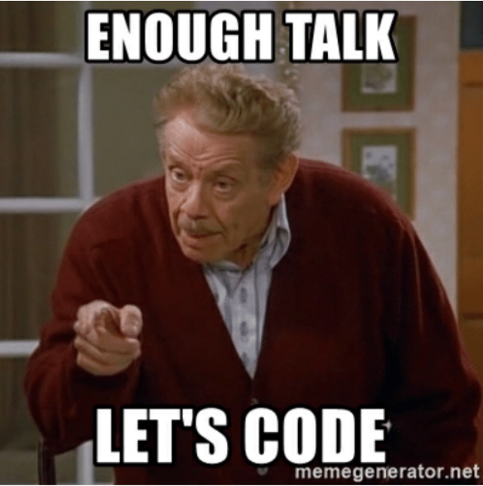

Slide 17
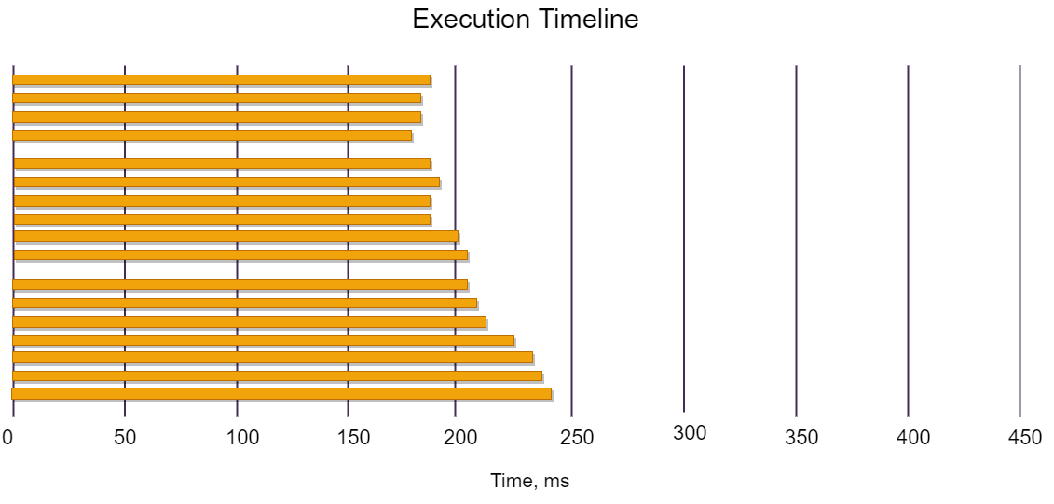
Concurrent HTTPS requests

Slide 18
Other modules and thread pool
Whenever possible, libuv delegate the async operations to the async primitives provided by OS, avoiding usage of the thread pool.
In short: Only if there is no other way, the thread pool will be used for asynchronous I/O. And yes HTTPS does not use the thread pool***.
And yes not all async goodness happens in thread pool
**Except of cases when it does

Slide 19
In fact it’s more complicated

Slide 20
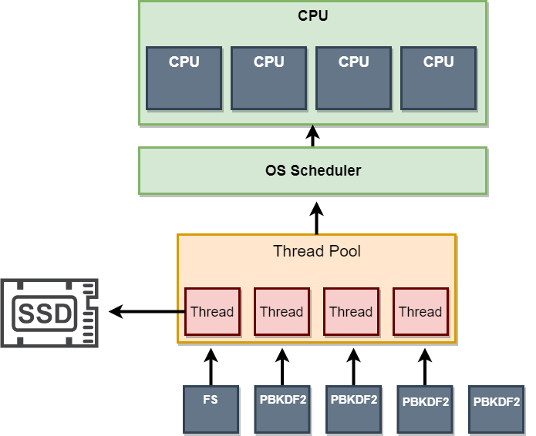
All the calls get one thread assigned
Thread assigned to fs operation requests tries to reach the disc
and get file stats and descriptor

Slide 21
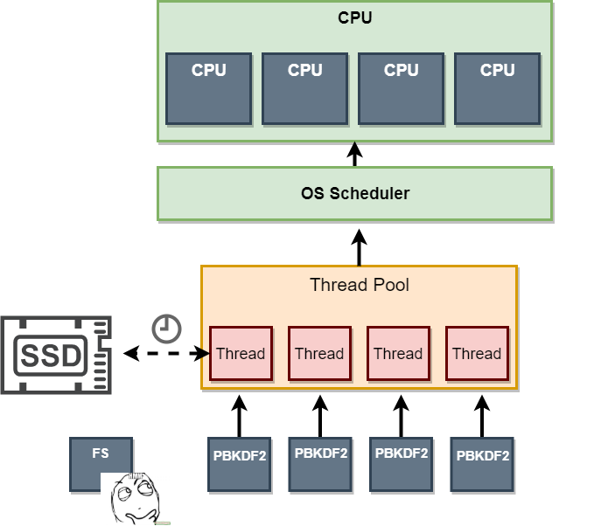
Async request to the disc starts
As far as that can take a while and the thread actually does not have anything to do it just puts fs request aside and processes queued hashing task

Slide 22
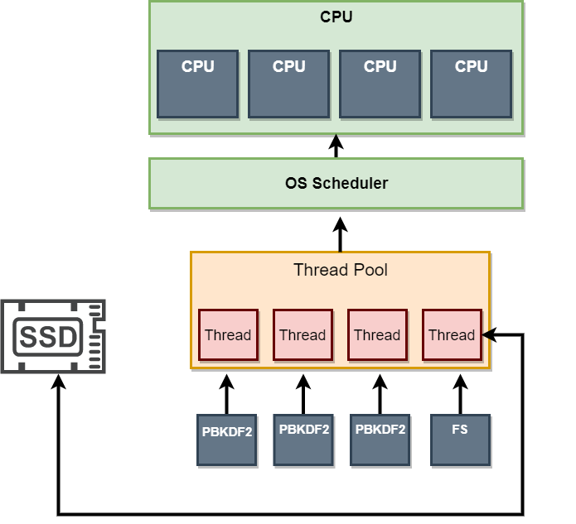
Once one of hashing functions is completed one of the threads is free to handle the initial response from fs and perform the actual reading of the file.

Slide 23
Setting up thread pool
UV_THREADPOOL_SIZE environment variable sets up the size of thread pool
Increasing thread pool size might have performance implications

Slide 24
UV_THREADPOOL_SIZE DEMO

Slide 25
Go get some coffee! NOW!

Slide 26
Event loop

Slide 27
What is event loop?
The event loop is what allows Node.js to perform non-blocking I/O operations — despite the fact that JavaScript is single-threaded — by offloading operations to the system kernel whenever possible.

Slide 28
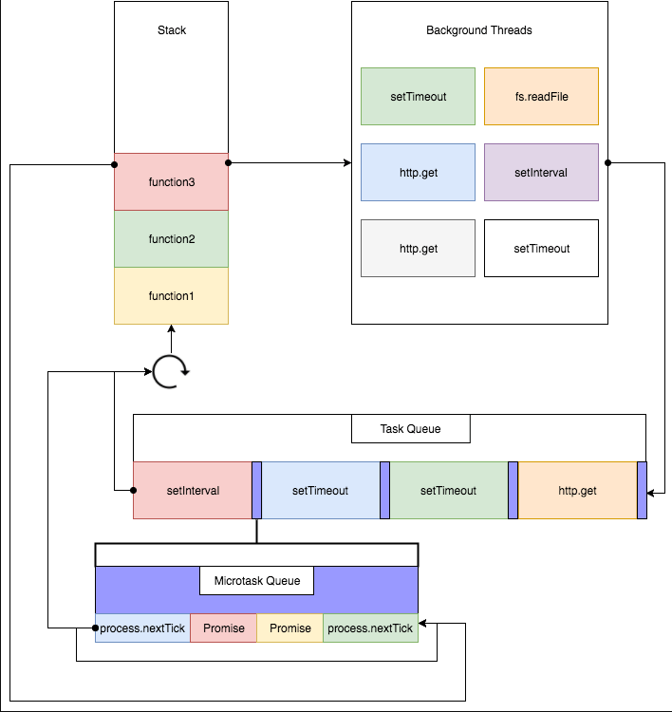
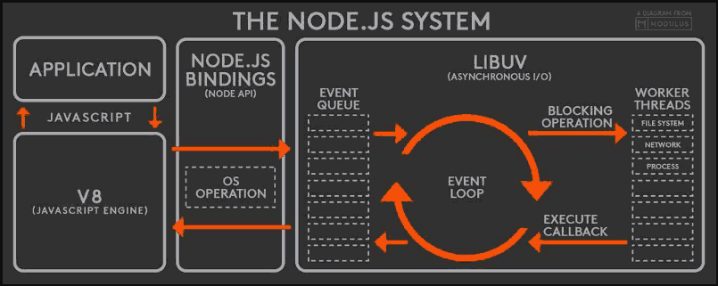
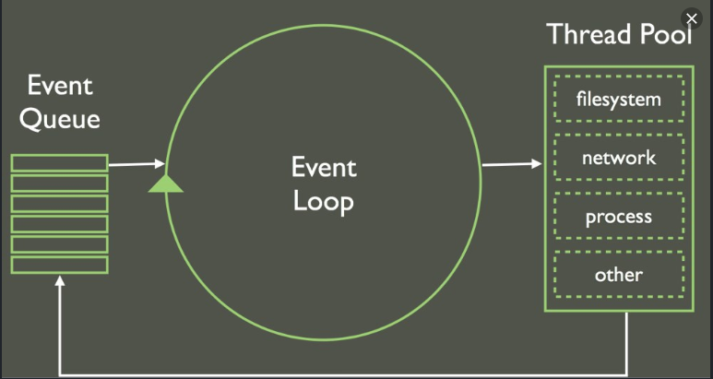
So how does it look like?

Slide 29
Previous slide is a lie

Slide 30
What is event loop?
The event loop is what allows Node.js to perform non-blocking I/O operations — despite the fact that JavaScript is single-threaded — by offloading operations to the system kernel whenever possible.

Slide 31
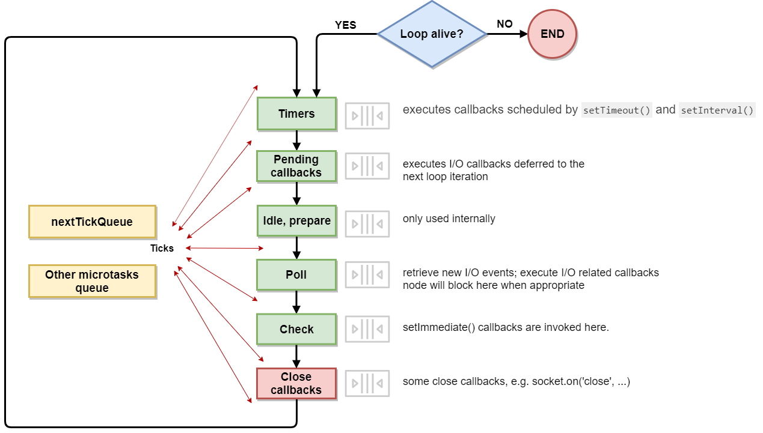
So how it really looks?*
*this diagram pretends to be the right one but yet it is still slightly simplified

Slide 32
Some more theory
Event loop consists of several phases
Each phase has a FIFO queue of callbacks to execute
Each phase executes some specific to it tasks at the beginning
Then the callback queue is executed until it is empty or the limit is reached
Then event loop moves to the next phase and so on

Slide 33
Timers phase #1
This phase executes callbacks scheduled by setTimeout() and setInterval()
Under the hood setTimeout() and setInterval() are the same functions but setInterval is called with repeat parameter
A timer specifies the threshold after which a provided callback may be executed
Operating System scheduling or the running of other callbacks may delay them

Slide 34
Timers phase #2
Timers created by setTimeout and setImmediate land up in a timer heap
Actual timer expiration and timers update is happening during poll phase
So the timers callback queue is formed in poll phase
There is no guarantee that the callback will be called exactly after the expiration

Slide 35
Pending callbacks
Executes I/O callbacks deferred to the next loop iteration
This phase executes callbacks for some system operations such as types of TCP errors. For example if a TCP socket receives ECONNREFUSED when attempting to connect, some *nix systems want to wait to report the error.
Technically this phase must be called error phase

Slide 36
I/O Polling #1
Retrieve new I/O events; execute I/O related callbacks
Here interaction with threadpool and underlying OS happens
Technically, the poll phase controls when timers are executed.

Slide 37
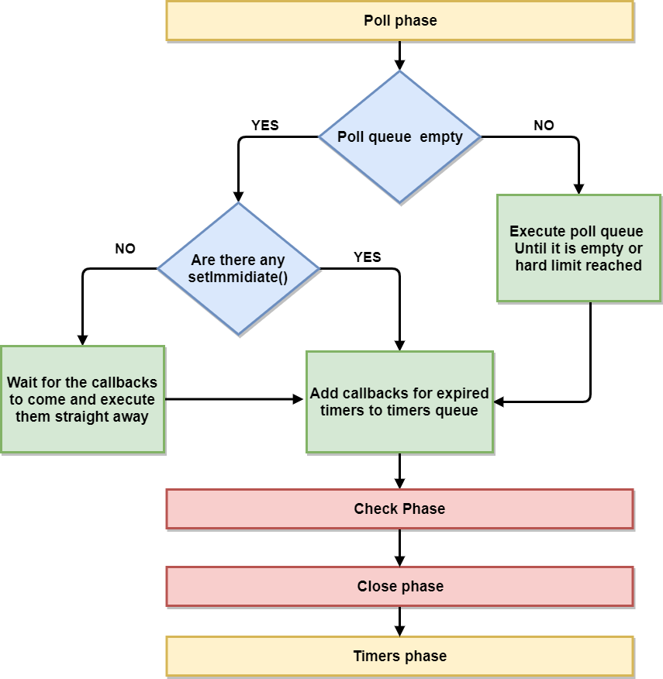
I/O Polling #2
The waiting part is quite tricky
In simple words Poll will wait for the callbacks if there are no other work to do and there are no set timers.
If there are timers the wait tile is limited to the closest timer threshold
See uv_backend_timeout uv__next_timeout uv__run_pending uv__loop_alive uv__io_poll uv_run for brutal truth
Notes:
Please read I/O phase as poll phase itself. There is no I/O phase
Thanks. This is what I suspected / wanted to hear. It was not clear from the original document.
Actually, I noticed right now that the document has changed a bit since I opened this issue. There is no more an I/O callbacks phase in the diagram.
Also, I see that executing timer callbacks is no longer listed as a function which the poll phase is responsible for. Perfect.
So, to recap, here is my current understanding of the event loop:
At any given time there is a (possibly empty) queue of I/O events.
Periodically, Node checks this queue.
If it's not empty, Node dequeues I/O events until the queue becomes empty (note: dequeue = execute callback).
When the queue is empty, Node starts polling for new I/O events.
The polling goes on until a new I/O event is fired (or the time to execute a setTimeout / setInterval callback has come).
In general, while an I/O event is being processed new I/O event may join the queue (note: process = execute callback).
As a consequence, even when the queue becomes empty its length may later grow again to a large number. And then it may go back to zero. Multiple times.
Each time the queue is empty, Node checks if there are setTimeout and setInterval callbacks to execute.
If there are, Node executes them and then switches back to polling / processing I/O events.
These procedure is repeated until there are no more setTimeous / setIntervals / async I/O to wait for, at which point Node exits.
Notes:
basically, points 2-7 correspond to the poll phase
points 8 a and 9 express the switch from poll phase to timers phase and vice versa
point 5 is achieved through a timeout for the polling based on the soonest setTimeout / setInterval
The explanation I gave so far can be refined in order to cover also setImmediate and process.nextTick:
setImmediate callbacks are executed as soon as the I/O event queue becomes empty (and thus have a somewhat higher priority than setTimeout / setInterval callbacks)
process.nextTick callbacks are executed at the end of the current "phase", where a phase can be one of the following:
execution of setTimeout / setInterval callbacks ("timers phase")
processing / polling I/O events ("poll phase")
execution of setImmediate callbacks ("check phase")
Note: there are other phases, but I think that for a high level discussion this is enough.
@gireeshpunathil , can you confirm that this is correct?
@marcoliceti - This is fantastic, looks great! few minor nits:
The polling goes on until a new I/O event is fired (or the time to execute a setTimeout / setInterval callback has come).
The polling goes on until a new I/O event is fired (or the time to execute a setTimeout / setInterval callback has come) or a system hard limit has reached. For example what if new events are always getting ready when you poll? It starves the rest of the system. So (in Linux) if you get mouthful (1024) of events for 48 consecutive iterations, the loop stops the current iteration.
If there are, Node executes them and then switches back to polling / processing I/O events.
9a. If there are none, and there are pending I/O events, Node goes into blocking (indefinite) poll until at least one event becomes ready.
The polling goes on until a new I/O event is fired (or the time to execute a setTimeout / setInterval callback has come) or a system hard limit has reached.
I wanted to add that as a note, but then I forgot it. Thanks!
9a. If there are none, and there are pending I/O events, Node goes into blocking (indefinite) poll until at least one event becomes ready.
Yes, but I think this is an implicit consequence of point 5 and the fact the it is implemented with a timeout based on the soonest setTimeout / setInterval: if there are no pending setTimeouts / setIntervals then there's no timeout for the polling.
Ok...
I think that finally everything is clear enough. Thank you all for the help :)

Slide 38
I/O Check phase
This phase allows a person to execute callbacks immediately after the poll phase has completed
If the poll phase becomes idle and scripts have been queued with setImmediate(), the event loop may continue to the check phase rather than waiting

Slide 39
setTimeout vs setImmediate
setImmediate() is designed to execute a script once the current poll phase completes
setTimeout() schedules a script to be run after a minimum threshold in ms has elapsed
Sometimes the order of execution might be unpredictable if not in I/O cycle

Slide 40
setImmediate vs setTimeout demo

Slide 41
Close phase
‘Close’ event is emitted in this phase when socket.Destroy() is called otherwise close is emitted via process.nextTick()

Slide 42
Microtasks queues
After each phase of event loop all the process.nextTick() and Promise.resolve() callbacks are processed
Technically process.nextTick() is not a part of event loop
Recursive calls to process.nextTick() might cause I/O starvation and blocking of event loop

Slide 43
Is process.nextTick even legal??
There are several cases it can be useful:
Passing down errors to callbacks after all the user code has executed
Allow the initialization prior to callback call
Request retries before event loop continues

Slide 44
process.nextTick demo

Slide 45
Is process.nextTick even legal? #2
Node documentation suggests to always favour setImmediate over process.nextTick.

Slide 46
Promises
Promises resolve callbacks are handled in between phases of event loop right after process.nextTick queue is processed

Slide 47
Microtasks and timers
Since node 11.x.x all microtasks scheduled in timer callback are executed right after the callback finishes. Even if there are other timer callbacks in queue.
This applies both to setTimeout and setImmediate

Slide 48
Timers and microtasks demo

Slide 49
Full event loop demo

Slide 50
Clinic and event loop delays measuring

Slide 51
Tools and further reading
https://clinicjs.org/
https://www.npmjs.com/package/autocannon

Slide 52
“Hardcore” async trickery demo

Slide 53
Q&A

